Slide 1
Introduction To Our Data
There are 17 columns
DBN : Unique code for each school in New York
School Name : Names of different schools
Category : Different type of enrolled candidates
Year
Total Enrollment : Total count of enrolled students
#Female : Female candidates
#Male : Male candidates
#Black : Candidates belonging to race - Black
#Hispanic : Candidates belonging to race - Hispanic
ELA #Test Takers : English Language Arts Test takers count
ELA #Level 1 : Candidates who appeared for Level 1 exam of ELA
ELA #Level 2 : Candidates who appeared for Level 1 exam of ELA
Math #Test Takers : Math Test takers count
MATH #Level 1 :Candidates who appeared for Level1 exam of Math
MATH #Level 2:Candidates who appeared for Level2 exam of Math
District Code : Schools belonging to 32 districts in New York
Borough Code : Schools belonging to 5 boroughs in New York

Slide 2
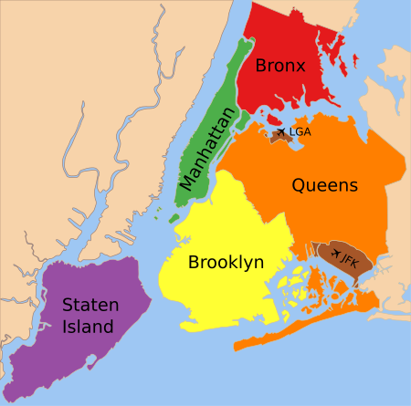
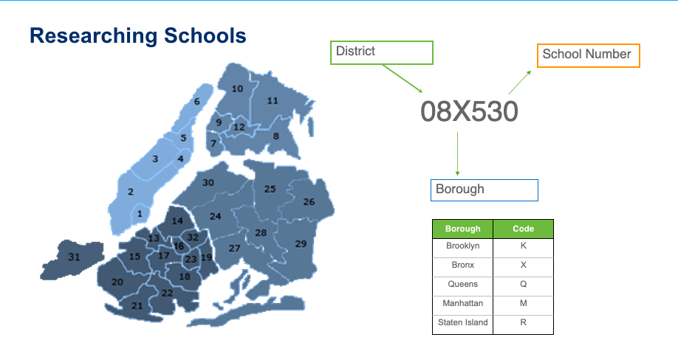
Data Cleaning
I found a lot of Null Values and corrupted values.
Most of the columns from the original dataset had to be removed due to higher null values.
Replaced Null values .
Created two new columns : District Code (32 Districts) and Borough Code (5 Boroughs) from the alphanumeric values in DBN column.

Slide 3
EDA
Students enrolled for ELA Test and Math test from different schools in New York.
Hypothesis:
Race of a student will affect the number of students enrolled for exams. Very debatable though!
Location of the school will affect the number of students enrolled for exams

Slide 4
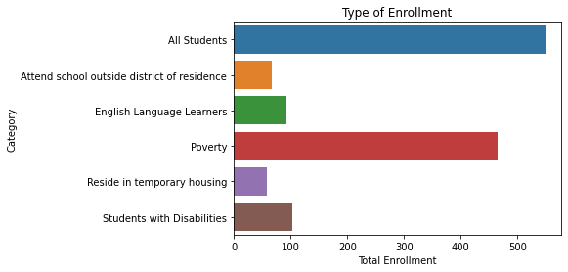
Total Enrollment
The maximum number of enrollments came from candidates who are just students and who do not belong to any other category
Students who reside in temporary housing has the least enrollment count.
Students who comes under the category of Poverty has the second highest enrollment. This is also an alarming fact that there are high number of students who belong to Poverty criteria in New York.

Slide 5
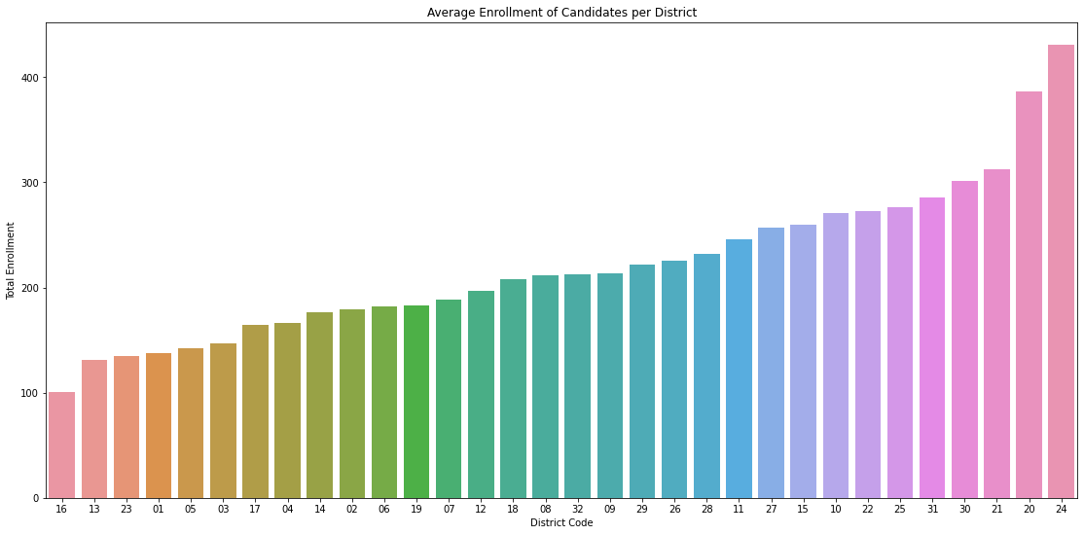
Average number of enrollments for exams from District No.24 was the highest
District No.16 had the least average enrollment.
Trying to understand the reason for low enrollment numbers from district codes would be helpful for future insights.

Slide 6
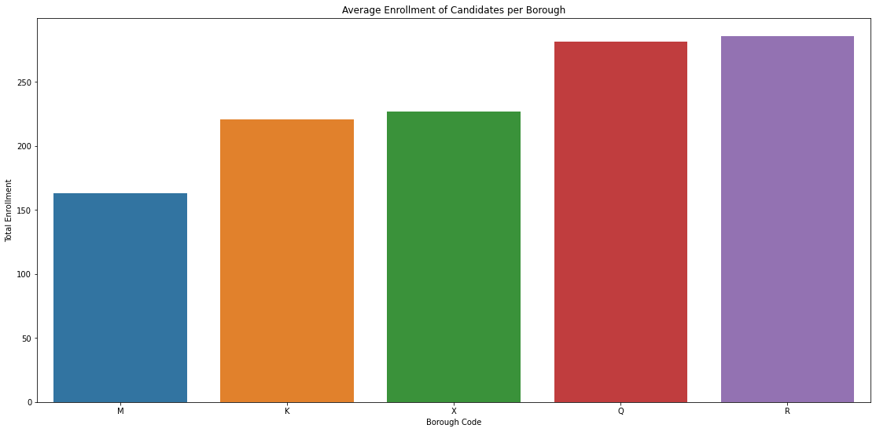
Highest enrollment was from Staten island while lowest was from Manhattan

Slide 7
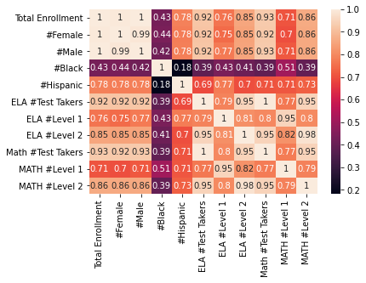
Race
Our data consists of students from two different races , Black and Hispanic.
I tried the correlational feature map and found that the students who belonged to Hispanic race had higher correlational values with other features compared to students who belonged to Black race.

Slide 8
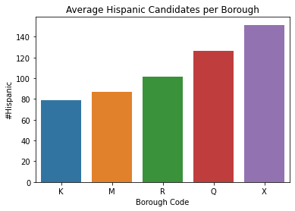
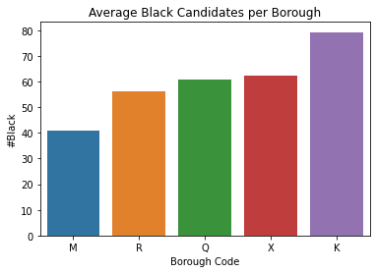
Bronx had the highest average number of Hispanic students
Manhattan had the lowest Black student enrollment
An interesting find was that Brooklyn had the highest average number of Black students but also the lowest average number of Hispanic students.
This could be due to different races community settlements in different boroughs or due to racial discrimination among schools from different boroughs .

Slide 9
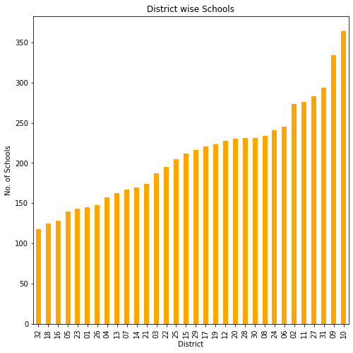
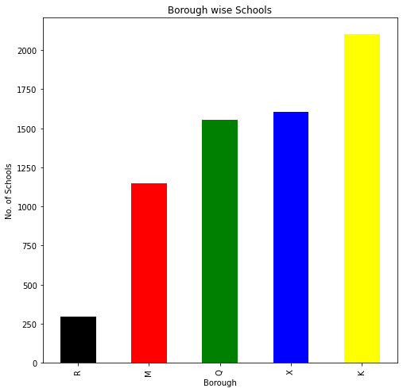
Schools
The number of schools from which students enrolled for exams was highest in Brooklyn and lowest in Staten Island.
District No .10 had the highest number of schools from which students enrolled for exams and lowest from District No.32

Slide 10
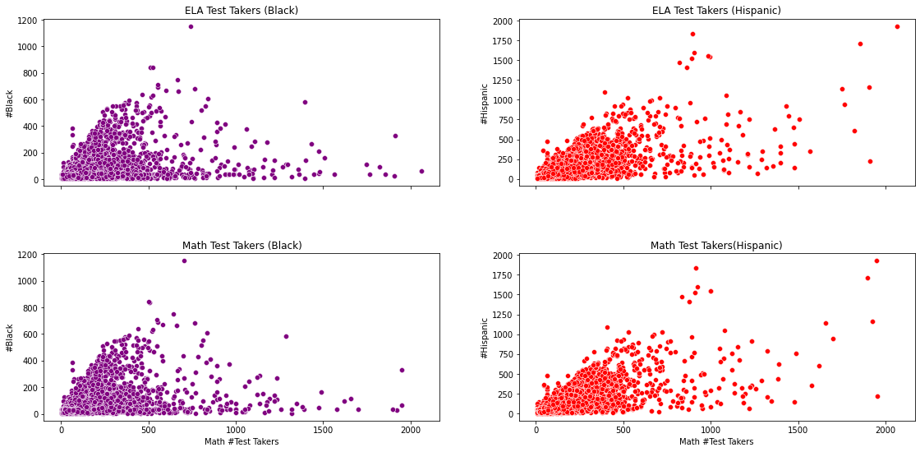
ELA and Math Test Takers
The number of Black students who appeared for exams showed lower increase with an increase in the number of ELA test takers and Math Test takers count compared to Hispanic students.
Also the presence of outliers can be seen in the chart.

Slide 11
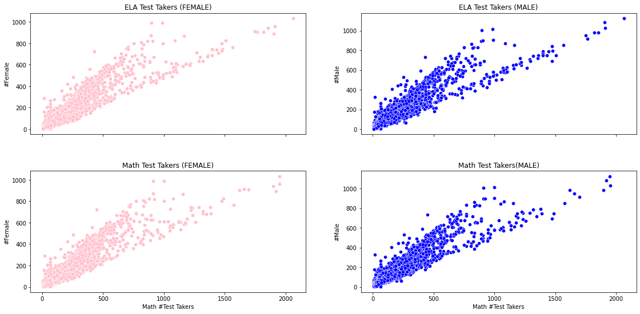
Gender didn’t had much an affect on the test takers count.
The average Female count was around 45% of Total Enrollment and average Male count was 55% of Total Enrollment.

Slide 12
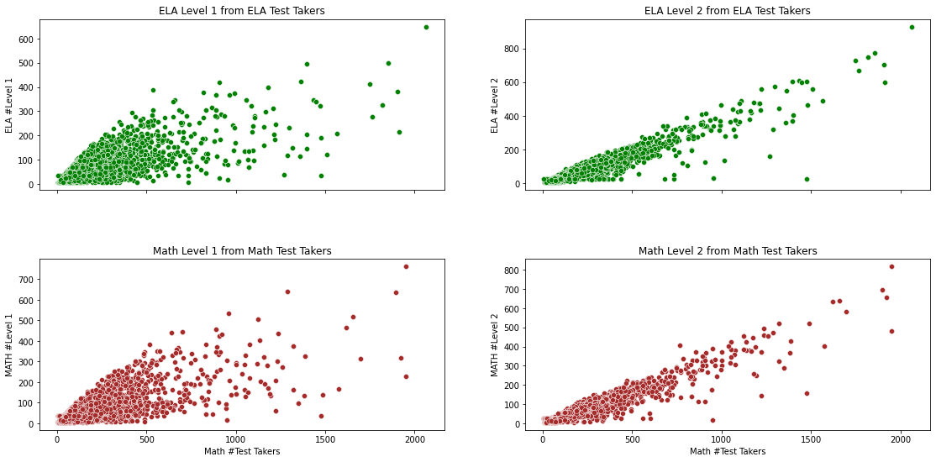
The below scatterplots shows Level 1 and Level 2 participation count from the total count of ELA and Math exam takers respectively.
Number of students who gave Level 2 of both exams shows higher correlation with Total Exam Takers than Level 1 students count.

Slide 13
Summary
Enrollment for exams was maximum when the candidates had these characteristics:
Candidates belonging to “All Students” category.
Belonging to District No.24
Belonging to Hispanic race.

